Slide 1

Next HIKES user Analytics in the Telecommunication Industry overview.
Project Name :- Scientific Calculator by using GUI
Made by :- Aman Sharma​

Slide 2
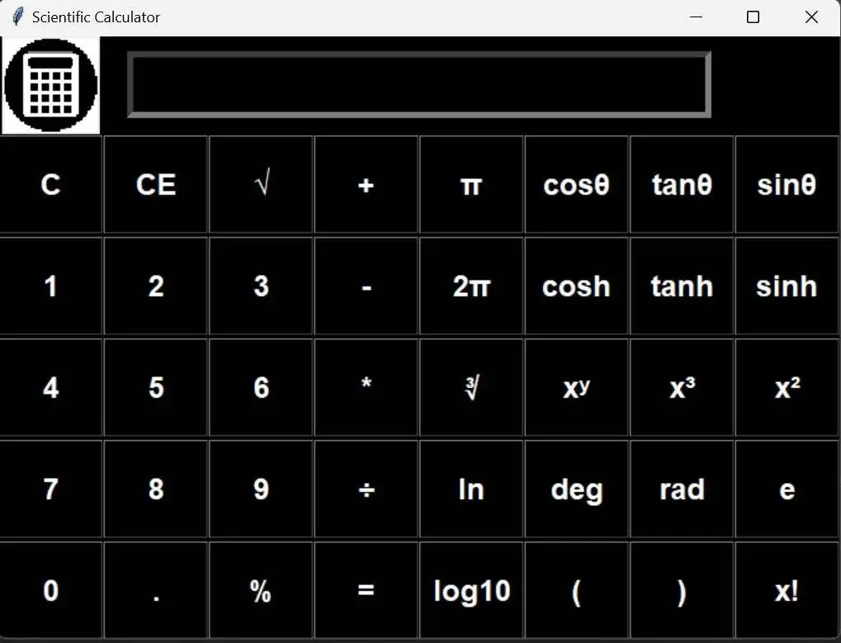
About the Project
A scientific calculator is an electronic calculator.
A scientific calculator is a specialized electronic device or software that can perform complex mathematical calculations, scientific functions, and statistical operations.
They have more buttons than a standard calculator. Scientific calculators are used by students, scientists, engineers, and professionals.
They are often used in math classes and on standardized tests, and are also used in fields like astronomy, physics, and chemistry.

Slide 3
1. Python provides various option for developing graphical user interface(GUI). The most impotant features are listed below. Tkinter = from Tkinter import * root – window object. font – The font style in which we want the information to get entered. bg – Stating the background color for the space. fg – Stating the color of the text appeared. bd – Border of the entry widget. width – width of the entry widget. Finally, with the help of “.grid()” we will set the position for the entry widget.
Tools Prepare for project for vs code
Python offers multiple options for developing GUI (Graphical User Interface). Out of all the GUI methods, tkinter is the most commonly used method. It is a standard Python interface to the Tk GUI toolkit shipped with Python. Python Tkinter is the fastest and easiest way to create GUI applications. Creating a GUI using Tkinter is an easy task.

Slide 4
Research and Development
Firstly , I had see all the videos with the help of internet. For installation of all software.
So, what the process of using python coding of vs code. For making scientific calculator with the help of GUI.
Then, I reading all the application for using this . And after that go through all the software install in my pc. Like python, vs code, qt design.
I had facing for more problems for running coding. But step by step resolve all the problem with the help of internet. Then I create the scientific calculator.
At last , but very interested project for given us . And it will gain to more knowledge. for help of IT industry.
Thanks for NEXT HIKES company for startup internship project.

Slide 5
Thank you

